Slide 1

Introduction To Machine Learning

Slide 2
AI vs ML vs Deep Learning
AI
A technique which enables machines to mimic human behaviour
ML
Subset of AI technique which use statistical methods to enable machines to improve with experience
DL
Subset of ML which make the computation of multi-layer neural network feasible

Slide 3
AI vs ML vs Deep Learning
AI
ML
DL

Slide 4
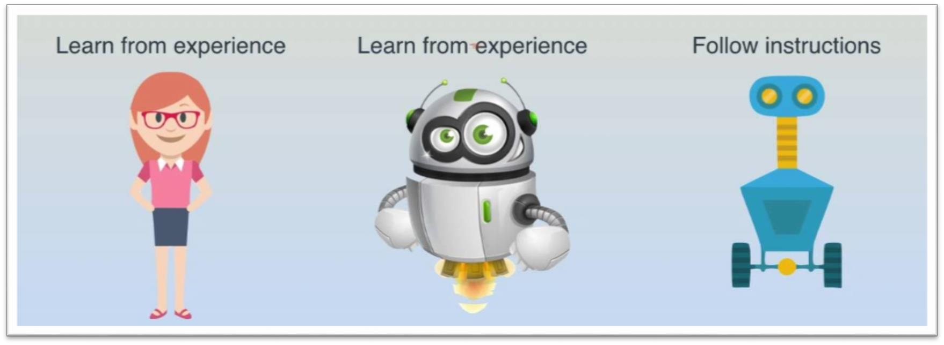
What is machine learning?
Machine learning: Science of getting computers to learn without being explicitly programmed
[Arthur Samuel, 1959]

Slide 5
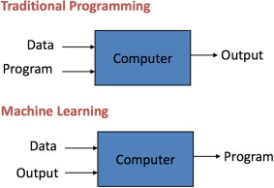
What is machine learning?
Traditional programming: Data and program is run on the computer to produce the output
Machine learning:
Data and output is run on the computer to create a program

Slide 6
What is machine learning?
Machine learning: A computer program learning from experience E, with respect to some task T, and some performance measure P, if its performance on T as measured by P improves with experience E
[Tom Mitchell, 1998]

Slide 7
Class Exercise
Suppose that your email program watches which emails you do or do not mark as spam and based on that learns how to better filter spam. What is task T in this setting?
Classifying the emails as spam or not spam
Watching you label the emails as spam or not spam
The number (or fraction) of emails correctly classified as spam or not spam
None of the above – this is not a machine learning problem
Notes:
B. (E) – C. (P)

Slide 8
Class Exercise
Supposed your email program watches which emails you do or do not mark as spam, and based on that learns how to better filter spam. What is task T in this setting?
Classifying the emails as spam or not spam
Watching you label the emails as spam or not spam
The number (or fraction) of emails correctly classified as spam or not spam
None of the above – this is not a machine learning problem

Slide 9
ML TYPES
Supervised
U
Unsupervised
R
Reinforcement
S

Slide 10
Supervised Learning
Examples come with the “right” answers (labeled data)
Predict a class or value
Predict a discrete value output
Examples: Yes or No, Disease or No Disease
Input variables, X
Classification
Learning algorithm, Y = f(X)
Goal: Approximate a mapping function (can predict Y for new X)
Predict a continuous value output
Examples: Price, Weight
Regression
Output variable, Y

Slide 11
Supervised Learning
Classification
Example: Predict breast cancer as malignant or benign
Y
1 (Y)
Malignant?
0 (N)
X
Tumor Size

Slide 12


Classification Task
Assign one or more class labels to each instance of data
Used car: For each car, assign whether the car would be unacceptable, acceptable, good or very good
Weather: For each day, assign whether to play tennis or not (yes or no)
 |  |  | Unacceptable
 |  |  | Acceptable
Used Car Condition?
 |  |  | Good
 |  |  | Very Good
 |  |  | Yes
Play tennis?
 |  |  | No
Notes:
Multiclass classification – Binary

Slide 13
Data: Terminologies
Instance, example, record: Each item of data with all of its info
Person, transaction, day, car, etc.
Represented as rows of a table
Attribute, field, feature, or variable: Items of information collected about each instance
Income, title, date, condition, etc.
Type can be categorical or continuous (numeric)
Represented as the columns of a table

Slide 14
Data: Magazine Sales Example
Each instance (row) is a magazine subscription
Each field or attribute (column) is data about the subscription
attribute
Client number | Client name | Date of birth | Income | Credit | Car owner | House owner | Address | Date of subscription | Magazine
23003 | Johnson | 13-04-76 | 18500 | 17800 | no | no | 1 Downing St. | 15-04-94 | car
23003 | Johnson | 13-04-76 | 18500 | 17800 | no | no | 1 Downing St. | 21-06-93 | music
23003 | Johnson | 13-04-76 | 18500 | 17800 | no | no | 1 Downing St. | 30-05-92 | comic
23009 | Clinton | 20-10-71 | 36000 | 26600 | yes | no | 2 Boulevard | NULL | comic
23013 | King | 15-08-70 | NULL | NULL | NULL | NULL | 3 High Road | 30-02-95 | sports
23003 | Johnson | 13-04-76 | 18500 | 17800 | no | no | 1 Downing St. | 20-12-94 | house
instance

Slide 15
Classification: Definition
Prepare data
Train model
Evaluate model
Run prediction
Given a collection of records (training set)
Each record contains a set of attributes, one of the attributes is the class label
Find a model for the class attribute as a function of the values of other attributes
Goal: Previously unseen records can then be assigned class as accurately as possible
Performance is given as the accuracy of the labeling
A test set is used to determine the accuracy of the model

Slide 16
Supervised Learning
Regression
Example: Predict housing prices
Y
400
300
200
100
Price in 1000’s
X
1000 1500 2000 2500 Size in feet²
0
500

Slide 17
Class Exercise
What types of machine learning problems are described below?
Problem 1: You have a large inventory of identical items to sell and you want to predict how many of these items you sell within the next 3 months.
Problem 2: You have many customers. For each account, decide whether or not the account has been hacked or compromised.

Slide 18
Class Exercise
What types of machine learning problems are described below?
Problem 1: You have a large inventory of identical items to sell and you want to predict how many of these items you sell within the next 3 months.
[Regression – Predict a value output]
Problem 2: You have many customers. For each account, decide whether or not the account has been hacked or compromised.
[Classification – Predict a discrete/category value output]
Notes:
it predict a value
it predict a class

Slide 19
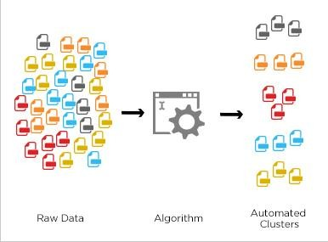
Unsupervised Learning
No answers for the examples (unlabeled data)
Looks for patterns or structure in unlabeled data
Find clusters or groupings of input
Examples: Grouping people into different categories, organize large computer clusters
Clustering
Learning Association
Finding association rules
Examples: Web usage mining, market basket analysis

Slide 20
Unsupervised Learning
Clustering
Example: Identify topics from news documents
X2
X1

Slide 21
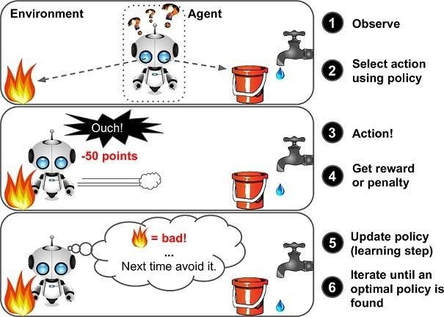
Reinforcement Learning
Output is a sequence of actions
Attain an objective or reach a goal
Examples: Find the best strategy to win a game, a robot navigating in an environment
Notes:
Reinforcement Learning is a feedback-based Machine learning technique in which an agent learns to behave in an environment by performing the actions and seeing the results of actions. For each good action, the agent gets positive feedback, and for each bad action, the agent gets negative feedback or penalty. In Reinforcement Learning, the agent learns automatically using feedbacks without any labeled data, unlike supervised learning.

Slide 22
Class Exercise
Of the following examples, which would you address using an unsupervised learning algorithm? Check all that apply.
Given emails labeled as spam or not spam, learn a spam filter
Given a set of news articles found on the Web, group them into sets of articles about the same stories
Given a database of customer data, automatically discover market segments and group customers into different market segments
Given a dataset of patients diagnosed as either having diabetes or not, learn to classify new patients are having diabetes or not

Slide 23
Class Exercise
Of the following examples, which would you address using an unsupervised learning algorithm? Check all that apply.
Given emails labeled as spam or not spam, learn a spam filter
Given a set of news articles found on the Web, group them into sets of articles about the same stories
Given a database of customer data, automatically discover market segments and group customers into different market segments
Given a dataset of patients diagnosed as either having diabetes or not, learn to classify new patients are having diabetes or not

Slide 24
Supervised Machine Learning
In Supervised learning, you train the machine using data which is well "labelled." It means some data is already tagged with the correct answer. It can be compared to learning which takes place in the presence of a supervisor or a teacher.
A supervised learning algorithm learns from labelled training data, helps you to predict outcomes for unforeseen data.

Slide 25
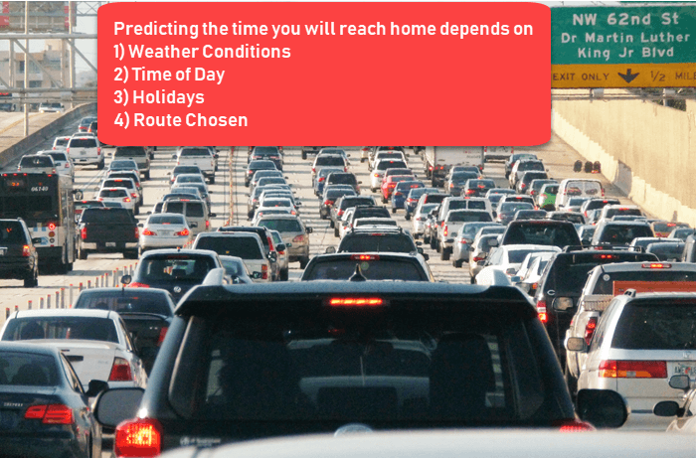
Example
Train a machine to predict how long it will take someone to drive home from the workplace.
Create a set of labelled data.
Input all the features
Output is travel time

Slide 26
Steps
Create a training set
This training set will contain the total commute time and corresponding factors like weather, time, …
Based on this training set, the machine might see there's a direct relationship between the amount of rain and time you will take to get home.
The more it rains, the longer you will be driving to get back to your home.
It might also see the connection between the time you leave work and the time you'll be on the road.
The closer you're to 6 p.m. the longer it takes for you to get home.
Your machine may find some of the relationships with your labelled data.

Slide 27
Types of Supervised Machine Learning
Regression
Logistic Regression
Naïve Bayes Classifier
Decision Treees
Support Vector Machine

Slide 28

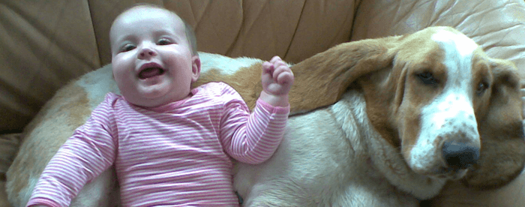
Example of Unsupervised Machine Learning

Slide 29
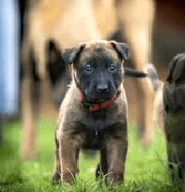
Example of Unsupervised Machine Learning
Let's, take the case of a baby and her family dog.
She knows and identifies this dog. Few weeks later a family friend brings along a dog and tries to play with the baby.
Baby has not seen this dog earlier. But it recognizes many features (2 ears, eyes, walking on 4 legs) are like her pet dog. She identifies the new animal as a dog. This is unsupervised learning, where you are not taught but you learn from the data (in this case data about a dog.)

Slide 30
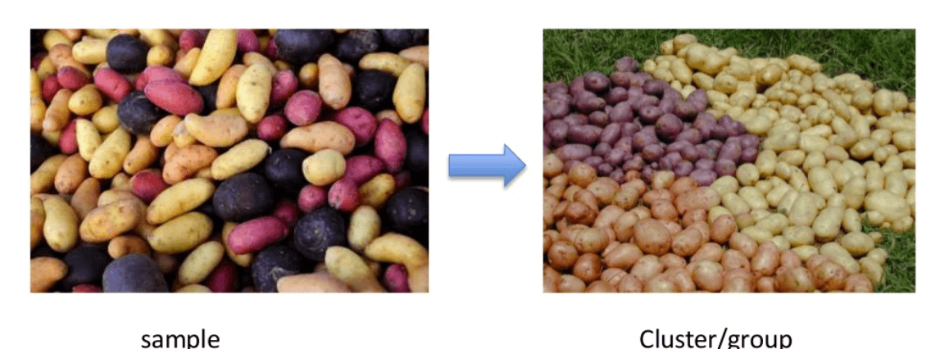
Types of Unsupervised Learning
Clustering
Clustering is an important concept when it comes to unsupervised learning. It mainly deals with finding a structure or pattern in a collection of uncategorized data.
Clustering algorithms will process your data and find natural clusters(groups) if they exist in the data.
You can also modify how many clusters your algorithms should identify. It allows you to adjust the granularity of these groups.

Slide 31
Unsupervised ML Algorithm
K-Means Algorithm
Hierarchical Clustering
Apriori Algorithm

Slide 32
Machine Learning: Categories
Supervised Machine Learning: Learn to predict target values from labelled data
Classification: Target values are discrete values
Regression: Target values are continuous values
Unsupervised Machine Learning: Find structure in labelled data
Find groups pf similar instances in the data (clustering)
Finding unusual patterns (outlier detection)

